Slide 1

- - - GRAPHIC DESIGN - - -
AKSHARA KALATHIL
ROLL:10
ST JOSEPH’S COLLEGE OF ENGINEERING AND TECHNOLOGY

Slide 2

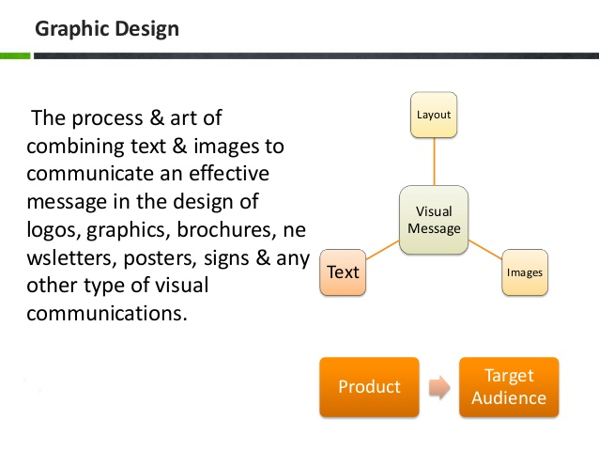
What Is Graphic Design?
The process and art of combining text and images to communicate an effective message in the design of logos , graphics , brochures , newsletters , posters , signs & any other type of visual communications

Slide 3
Graphic design elements
Graphic design elements are the building blocks of Graphics
Line
Shape
direction
Texture
Color

Slide 4

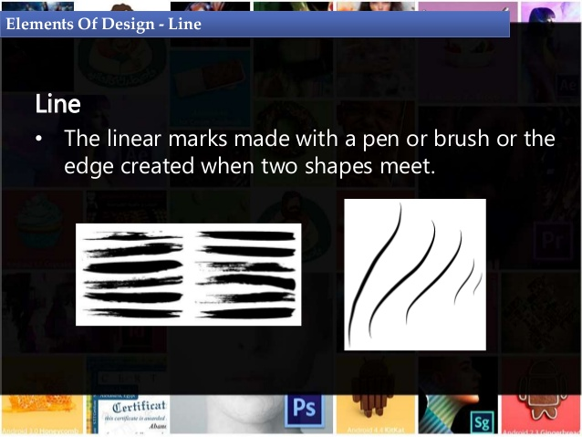
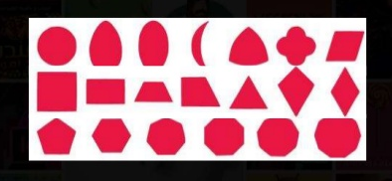
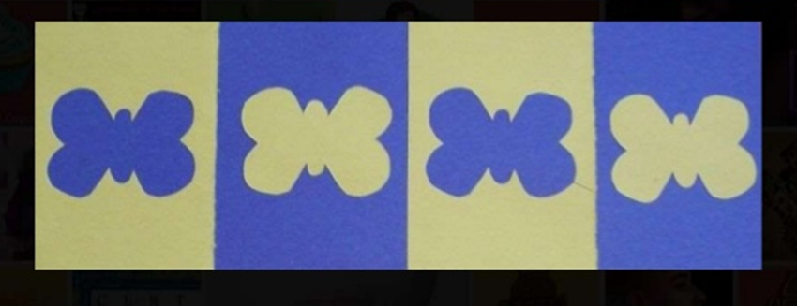
Line
The linear marks made with a pen or brush or the edge created when two shapes meet.
Shape
A shape is a self contained defined area ex. Squares , circles , free formed shapes or natural shapes
A positive shape automatically creates a negative shape.

Slide 5
3. Direction
All lines have directional , vertical or oblique
Horizontal suggests calmness , stability and tranquility
Vertical gives a feeling of balance , formality and alertness
Oblique suggests movement and action
4. Texture
Texture is the surface quality of a shape – rough , smooth ,soft hard glossy etc.
5. Color
Color is light reflected off objects
Color has three main characteristics:
→ hue or its name (red , green , blue, etc.)
→ value(how light or dark it is)
→ intensity (how bright or dull it is)

Slide 6
Principles of design
The principles of design are what we do to design elements . How we apply the principles of design how successful the design is
Balance
Proximity
Alignment
Repetition
Contrast
Space

Slide 7

What is User Interface design ?

Slide 8

UI
UX
“ How it looks
“ How it feels
HUMAN-FIRST APPROACH
TO PRODUCT DESIGN
HUMAN-FIRST APPROACH TO
DESIGNING THE AESTHETIC
EXPERIENCE OF A PRODUCT
→ Visual Design
Rooted on GRAPHIC DESIGN
Focusing more on form and
aesthetics
organisation of the information
Graphic driven
Non-Visual Design
Research and planning
Testing
Navigation structure
By the user’s experience and the feedback from the user
User driven

Slide 9
Applications of Graphic design
Website design
Logo and brochures design
Package design
Banner design
Animated graphic design

Slide 10


